Slide 1

BANK APPICATION
Batch-86
Team :B
This case study is on bank application
Presented by
Hanumantha Reddy
Poojitha Unnam
Roshini MohanKumar
Sandhya Lokesh

Slide 2
SBI BANK APP
FOR USER :User can login , after succesful login , user can Search for required loans, for example – home loan , vehicle loan it will display loan interest percentage and calculate the loan amount
DB MANAGER : The db manager is used for connecting to database
By using this module we can get the required data from the database like mobile details

Slide 3
Main class
Ui part of the project were the user registers / logins
Inputs like :
Firstname
Lastname
Phone number
Address line
Data processing :
All the methods are called here
Once the user login is successful the user can search for a particular mobile .The details of the mobile will be displayed and the product can be added to cart

Slide 4
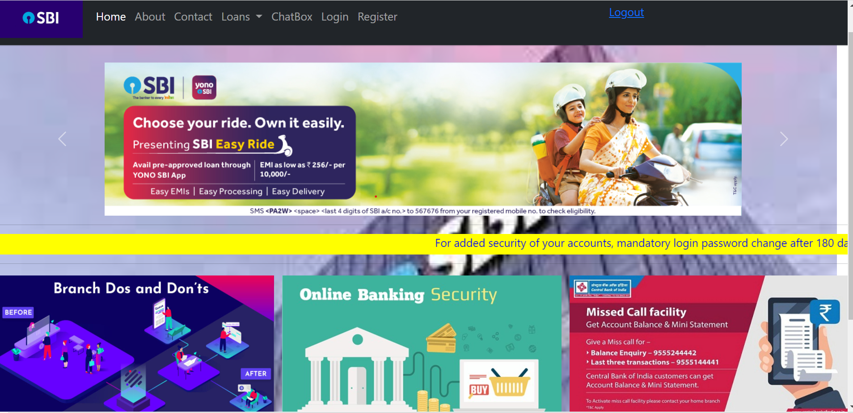
Home page

Slide 5
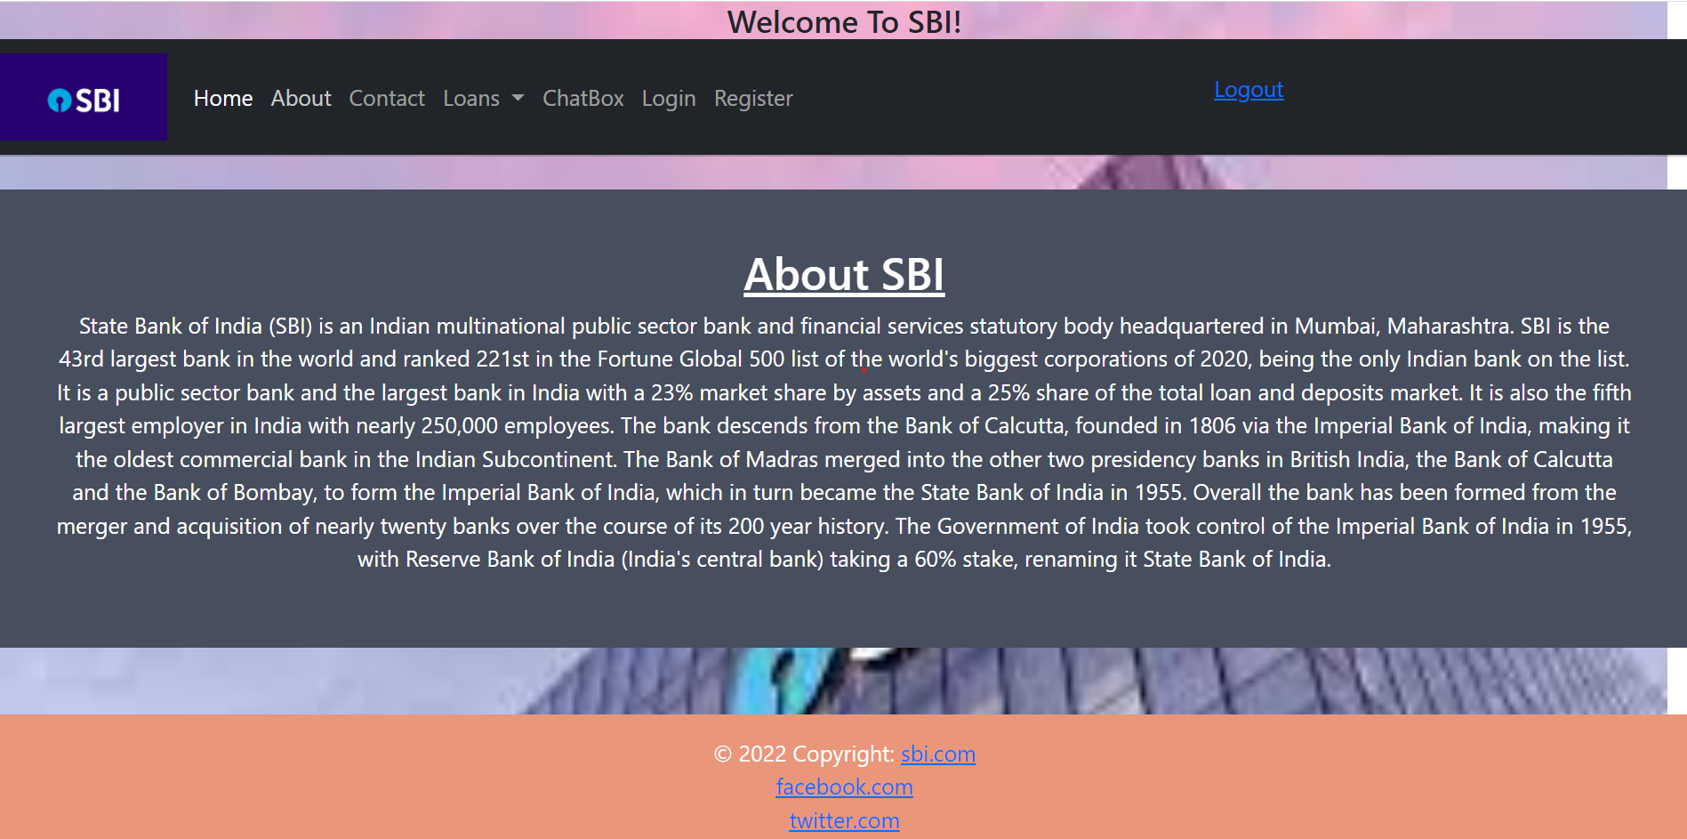
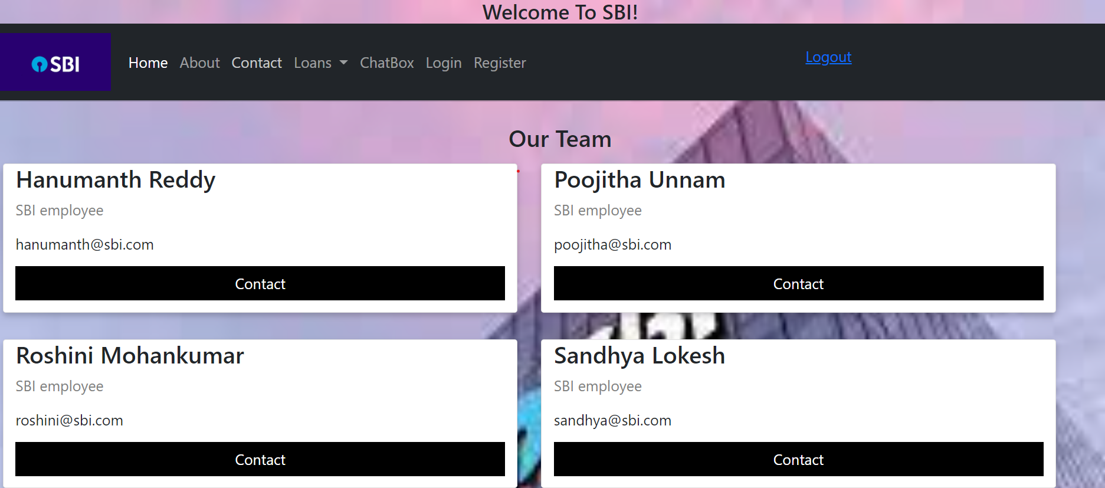
About & Contact

Slide 6
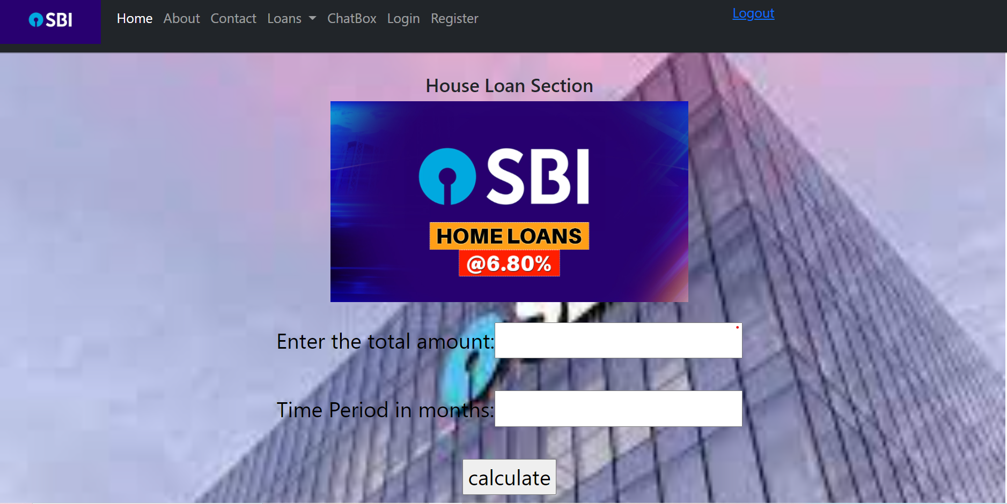
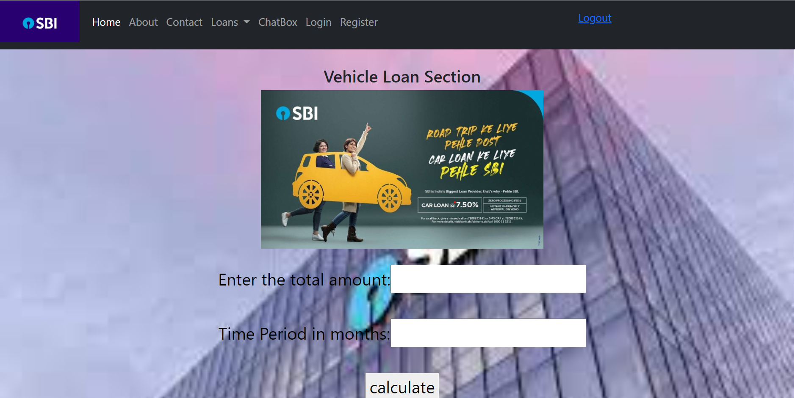
Home loan & Vehicle loan

Slide 7
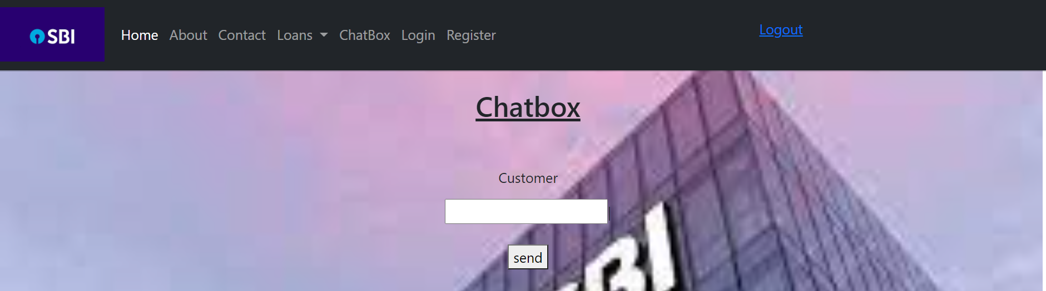
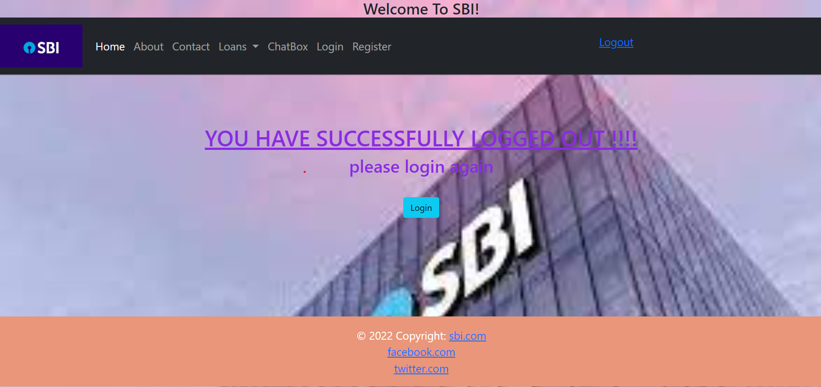
Chatbox & Logout

Slide 8
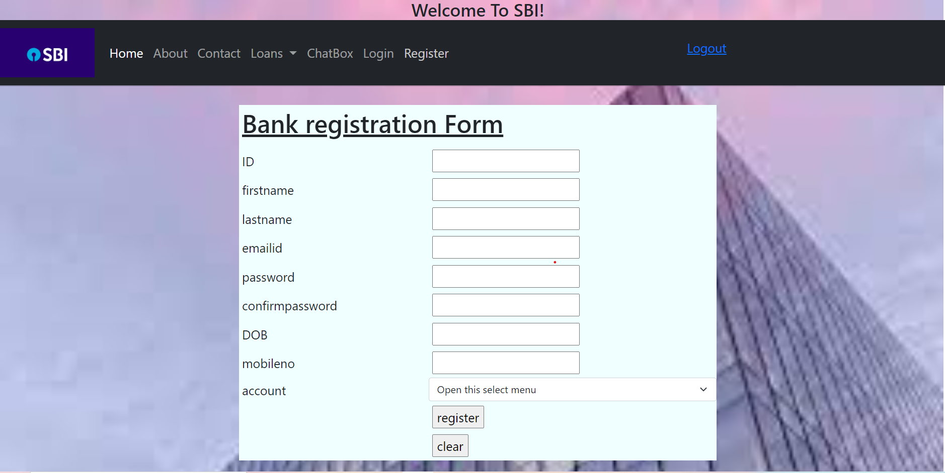
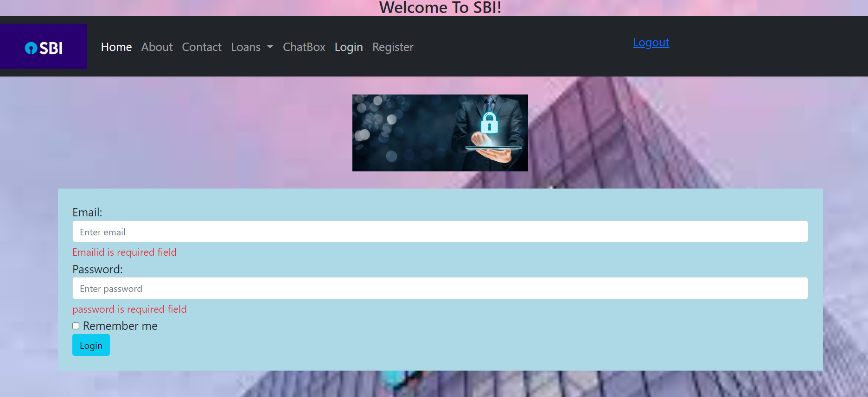
User registration & Login

Slide 9
Thank you

